Slide 1



RNS INSTITUTE OF TECHNOLOGY
Department of Computer Science & Engineering
Project Phase-1: Screening
Swarm-based Agriculture Monitoring System (SAMS)
Student Names:
Abhijeeth K V [1RN23CS005]
Akarsh Raj M Hulihalli [1RN23CS018]
Deepthi D R [1RN23CS068]
Jaishnav Kalmangi [1RN23CS092]
Guide Name:
Ms. Chethana H R
Assistant Professor
Dept. of CSE, RNSIT

Slide 2
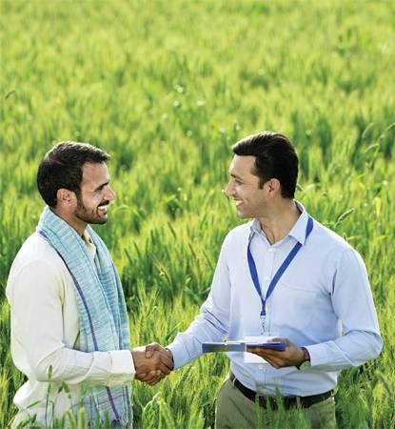
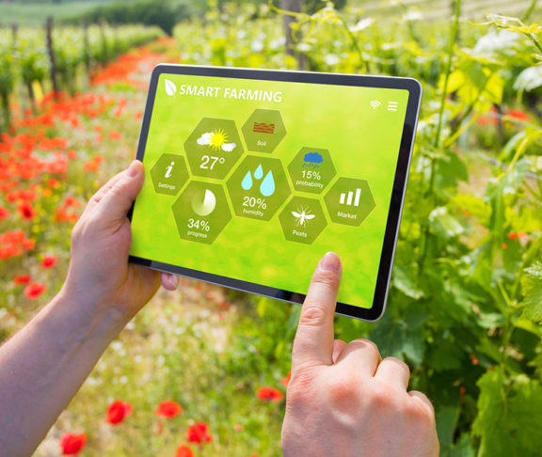
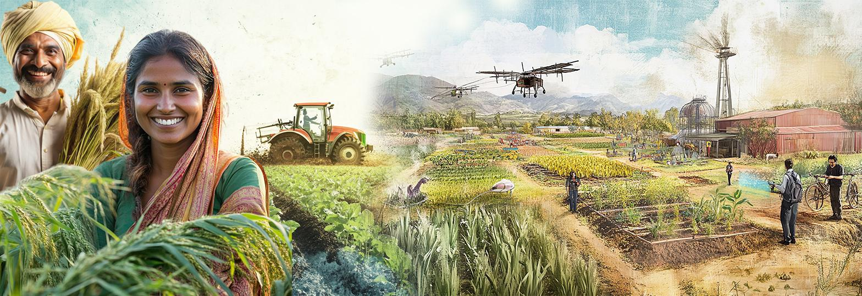
AGENDA
Introduction
Literature Survey
Problem Statement & Objectives
Methodology
References
12/03/2026

Slide 3
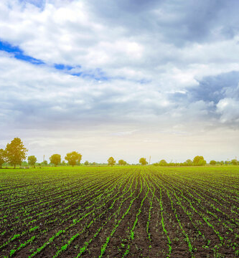
INTRODUCTION
Agriculture is a critical sector that requires continuous monitoring of environmental conditions such as soil moisture, temperature, and humidity to ensure optimal crop growth.
Traditional farming practices often rely on manual monitoring, which can be inefficient and inaccurate. Modern IoT-based monitoring systems improve data collection but typically rely on centralized architectures, which can suffer from sensor failures and unreliable readings.
Swarm intelligence, inspired by the collective behavior of natural systems such as ant colonies and bird flocks, enables distributed and collaborative decision-making among multiple nodes.
This project proposes a swarm-based agriculture monitoring system where sensor nodes communicate with each other, validate data collectively, and provide intelligent insights to the analytics dashboard.
12/03/2026

Slide 4
LITERATURE SURVEY
Papers referred:
Sl. No. | Paper / Study | Work Done | Technologies / Methods Used | Limitations
1 | Swarm Intelligence: A Survey of Model Classification and Applications (2025) | Reviews swarm intelligence models inspired by collective behavior in animals such as ants, birds, and fish. Explores how distributed agents collaborate to solve complex problems. | Swarm models, Ant Colony Optimization (ACO), Particle Swarm Optimization (PSO), Artificial Bee Colony, multi-agent systems. | Mostly theoretical models and simulations; limited real-world implementations in practical systems.
2 | Internet of Things and Smart Sensors in Agriculture: Scopes and Challenges (2023) | Discusses the role of IoT and smart sensors in precision agriculture for monitoring soil, weather, pests, and crop conditions. | IoT sensors, wireless sensor networks, UAVs, AI and machine learning, cloud data processing. | High implementation cost, data security concerns, lack of digital awareness among farmers.
3 | IoT-Based Smart Agriculture Monitoring System (2024) | Proposes an IoT-based system to monitor environmental conditions such as soil moisture, temperature, and humidity to improve crop productivity. | ESP32 microcontroller, DHT11 sensor, soil moisture sensor, WiFi communication, Blynk mobile application. | Focuses mainly on basic monitoring and irrigation automation; lacks advanced analytics or distributed collaboration between sensors.
4 | MQTT Protocol for the IoT (2023) | Explains MQTT as a lightweight communication protocol for IoT devices to efficiently exchange messages over networks. | Publish–subscribe architecture, MQTT broker, MQTT clients, TCP/IP communication, QoS levels. | Requires centralized broker; limited built-in security features; scalability challenges for very large systems.
5 | Swarm-Based Optimization Algorithms (2023) | Introduces swarm-based algorithms inspired by natural collective behavior to solve optimization problems. | Ant Colony Optimization, Particle Swarm Optimization, Artificial Bee Colony, Cuckoo Search algorithms. | Parameter tuning challenges, computational complexity, limited integration with real-time IoT environments.
6 | Swarm Robotics and Multi-Agent Systems in Agriculture (2025) | Explores use of multiple cooperative robots for agricultural tasks such as monitoring crops, irrigation, pest detection, and harvesting. | Multi-agent systems, robotic sensors, AI/ML algorithms, wireless communication, GPS navigation, computer vision. | High hardware cost, communication challenges between robots, energy constraints and coordination complexity.
12/03/2026

Slide 5
LITERATURE SURVEY (continued…)
Sl. No. | Paper / Study | Work Done | Technologies / Methods Used | Limitations
7 | A Comprehensive Review on IoT in Smart Agriculture (2024) | Reviews how IoT is used for crop monitoring and smart irrigation. | IoT sensors, wireless networks, cloud platforms. | High cost and connectivity issues in rural areas.
8 | Smart Sensors and Smart Data for Precision Agriculture (2024) | Discusses modern sensors used for monitoring soil, crops, and environment. | Smart sensors, remote sensing, data analytics. | Centralized architecture and large data processing requirements.
9 | Artificial Intelligence of Things (AIoT) for Precision Agriculture – A Review (2025) | Explores integration of AI and IoT for crop monitoring and farm automation. | AI algorithms, IoT sensors, cloud computing. | Requires large datasets and reliable network connectivity.
10 | A Literature Review on IoT in Smart Agriculture (2025) | Reviews IoT technologies used to improve agricultural productivity. | IoT devices, environmental sensors, mobile apps. | Security issues and infrastructure cost.
11 | Integration of Smart Sensors and IoT in Precision Agriculture (2025) | Examines how sensors and IoT help optimize irrigation and fertilizer usage. | Soil sensors, IoT communication protocols, monitoring systems. | Energy limitations and scalability challenges.
12 | Machine Learning-Based Precision Agriculture with IoT Sensors – Review (2026) | Reviews machine learning methods for analyzing agricultural sensor data. | Machine learning models, IoT sensor networks, data analytics. | High computational requirements and limited real-world deployment.
12/03/2026

Slide 6
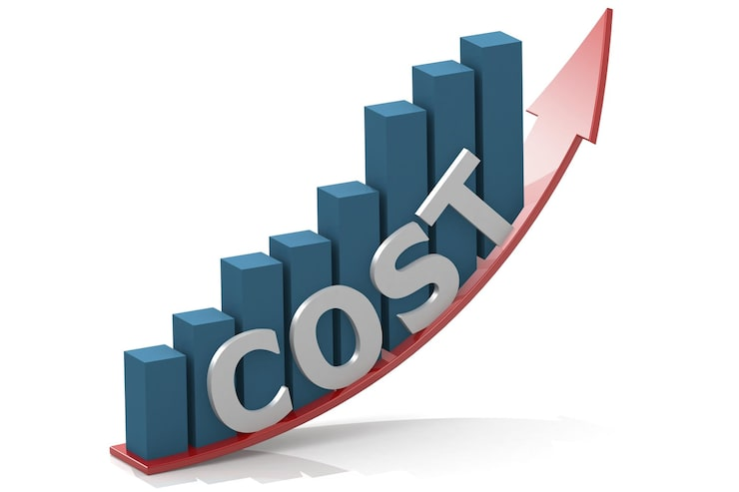
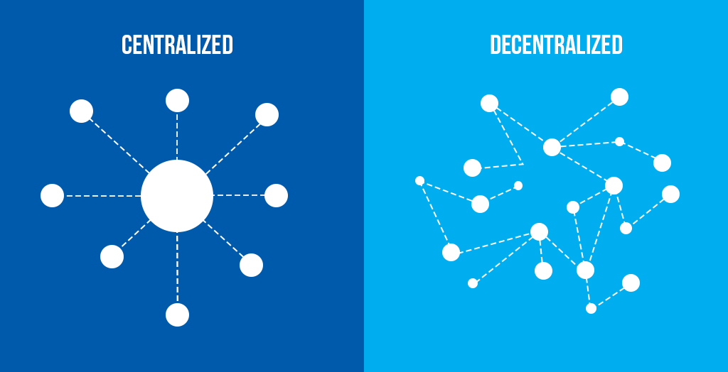
Conclusion from going through the papers:
Existing agricultural monitoring systems use IoT sensors and wireless networks to collect data such as soil moisture, temperature, and humidity for crop monitoring.
These systems typically rely on microcontrollers (e.g., ESP32/Arduino), cloud platforms, and communication protocols like MQTT to transmit and visualize real-time farm data.
Research in swarm intelligence and multi-agent systems shows that distributed agents can collaboratively perform tasks such as monitoring, optimization, and decision making without centralized control.
Although these technologies improve monitoring and automation, many implementations involve high deployment costs, centralized architectures, or simulation-based swarm models rather than practical distributed systems.
Most current systems mainly focus on data collection and basic automation, with limited emphasis on intelligent anomaly detection, collaborative validation between nodes, and scalable swarm-based monitoring.
12/03/2026

Slide 7
Existing Systems | Limitations | Research Gap
Use centralized IoT systems where sensors send data to a single server/cloud. | Single point of failure and limited scalability. | Need for distributed/swarm-based monitoring systems.
Collect and display basic environmental data (soil moisture, temperature, humidity). | Mostly monitoring only; limited anomaly or fault detection. | Need for intelligent fault/anomaly detection.
Use expensive hardware or complex setups in some smart farming solutions. | High deployment cost for large farms. | Need for low-cost monitoring systems using simple sensor nodes.
Use communication protocols for IoT data transfer. | Some systems use heavy or inefficient communication methods. | Need for lightweight protocols (e.g., MQTT) for efficient communication.

Slide 8
PROBLEM STATEMENT
Agricultural monitoring is often done through manual observation or basic systems, which makes it difficult to continuously track environmental conditions such as soil moisture, temperature, and humidity. This lack of real-time monitoring makes it hard to detect anomalies or sudden changes that may affect crop health and irrigation decisions. Additionally, many existing monitoring systems rely on centralized architectures and limited data analysis capabilities. Therefore, there is a need for a smart monitoring system that can continuously collect environmental data, detect abnormal conditions, and support better agricultural management through data-driven insights.
12/03/2026

Slide 9
Objectives
To design and implement a distributed agricultural monitoring system using multiple sensor nodes deployed across the field for real-time data acquisition.
To enable swarm-based communication among sensor nodes for collaborative data sharing, validation, and decentralized operation.
To continuously monitor key environmental parameters such as soil moisture, temperature, and humidity to support optimal crop growth and irrigation planning.
To analyse collected data for detecting abnormal environmental conditions and to generate timely alerts for effective decision-making.
To develop a centralized dashboard for real-time visualization and monitoring, ensuring scalability and fault tolerance of the overall system.
12/03/2026

Slide 10
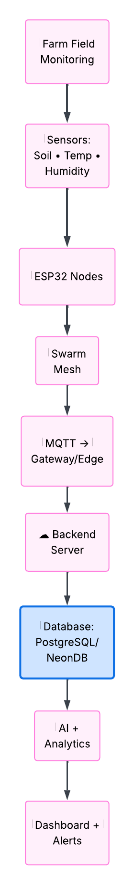
METHODOLOGY
Cloud Deployment
1. Sensor Data Collection Environmental parameters such as soil moisture, temperature, and humidity are collected using sensors connected to ESP32 microcontroller nodes.
2. Swarm-Based Communication Multiple sensor nodes form a distributed network where nodes communicate with each other and transmit data using lightweight communication protocols such as MQTT.
3. Data Transmission to Backend The collected data is transmitted to a backend server where it is processed and stored in a database.
4. Data Processing and Analytics The backend system analyzes the sensor data to identify abnormal conditions or anomalies in environmental parameters.
5. Visualization and Monitoring Dashboard The processed data is displayed through a web-based dashboard that provides real-time monitoring, visualizations, and alerts.
12/03/2026

Slide 11
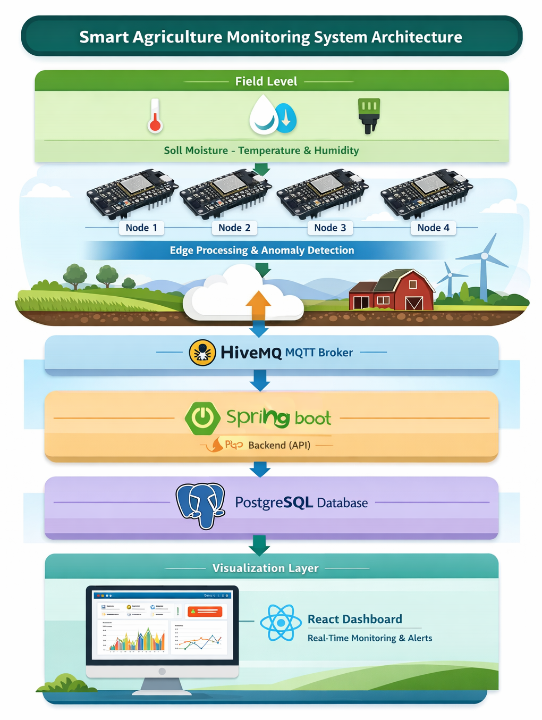
ARCHITECTURE
Sensor Layer: Soil moisture and DHT sensors collect environmental data such as soil moisture, temperature, and humidity from different locations in the farm.
Edge Layer (ESP32 Swarm Nodes): Four ESP32 nodes act as swarm agents that read sensor data, share readings with other nodes, and perform basic anomaly detection at the edge.
Communication Layer: Sensor nodes communicate using the MQTT protocol through an MQTT broker (HiveMQ), enabling lightweight publish–subscribe messaging between devices and the backend.
Backend Processing: A Spring Boot backend service subscribes to MQTT topics, processes incoming sensor data, and exposes REST APIs for data access.
Data Storage: Sensor readings, node status, and anomaly information are stored in a PostgreSQL database for persistence and historical analysis.
Visualization Layer: A React-based dashboard with chart visualizations provides real-time monitoring, historical trends, and anomaly alerts for farm conditions.
Architecture Style: The system follows a hybrid edge–cloud architecture, where ESP32 nodes perform edge-level validation while cloud services handle storage, analytics, and visualization.
12/03/2026

Slide 12
OUTCOMES
Prototype of a swarm-based agriculture monitoring system.
Real-time environmental data collection from multiple nodes.
Reliable MQTT communication with backend storage.
Anomaly detection from sensor data.
Web dashboard for live monitoring and alerts.
Improved monitoring compared to single-node systems.
Demonstration of practical swarm intelligence in agriculture.
Ultimately, the system aims to support smarter farming practices, reduce manual effort, enable data-driven decisions, and contribute to sustainable agriculture.

Slide 13
REFERENCES
[1] Swarm intelligence - https://en.wikipedia.org/wiki/Swarm_intelligence
[2] Swarm Intelligence: A Survey of Model Classification and Applications - https://www.sciencedirect.com/science/article/pii/S1000936124000931
[3] Internet of Things and Smart Sensors in Agriculture: Scopes and Challenges - https://www.sciencedirect.com/science/article/pii/S2666154323002831
[4] IoT-Based Smart Agriculture Monitoring System - https://www.researchgate.net/publication/388173169_IoT-BASED_SMART_AGRICULTURE_MONITORING_SYSTEM
[5] MQTT Protocol for the IoT - https://www.researchgate.net/publication/373640610_MQTT_Protocol_for_the_IoT_-_Review_Paper
[6] Swarm-Based Optimization Algorithms - https://onlinelibrary.wiley.com/doi/abs/10.1002/047134608X.W8352
[7] Swarm Robotics and Multi-Agent Systems in Agriculture - https://www.researchgate.net/publication/392440423_Swarm_Robotics_and_Multi-Agent_Systems_in_Agriculture#:~:text=Swarm%20robotics%20and%20multi%2Dagent%20systems%20represent%20a%20transformative%20approach,and%20resilience%20in%20farming%20operations.
[8] A Comprehensive Review on IoT in Smart Agriculture - https://www.sciencedirect.com/science/article/pii/S2772375524000923
[9] Smart Sensors and Smart Data for Precision Agriculture - https://www.mdpi.com/1424-8220/24/8/2647
[10] Artificial Intelligence of Things (AIoT) for Precision Agriculture – A Review - https://www.sciencedirect.com/science/article/pii/S2772375525008603
[11] A Literature Review on IoT in Smart Agriculture - https://www.researchgate.net/publication/388320488_A_LITERATURE_REVIEW_ON_IOT_IN_SMART_AGRICULTURE
[12] Integration of Smart Sensors and IoT in Precision Agriculture - https://www.frontiersin.org/journals/plant-science/articles/10.3389/fpls.2025.1587869/full
[13] Machine Learning-Based Precision Agriculture with IoT Sensors – Review - https://link.springer.com/article/10.1007/s44274-025-00305-8
12/03/2026

